Slide 1


Using CareSearch & palliAGED resources - Grief and Bereavement
CareSearch is funded by the Australian Government Department of Health, Disability and Ageing

Slide 2


The University acknowledges the Traditional Owners and Custodians of the lands on which its campuses are located, these are the Traditional Lands of the Arrernte, Dagoman, First Nations of the South East, First Peoples of the River Murray & Mallee region, Jawoyn, Kaurna, Larrakia, Ngadjuri, Ngarrindjeri, Ramindjeri, Warumungu, Wardaman and Yolngu people. We honour their Elders past, present and emerging.
CareSearch is funded by the Australian Government Department of Health, Disability and Ageing

Slide 3

Aim of presentation:
Using CareSearch and palliAGED resources to support practice
Grief reactions and supportive resources
Further learning
CareSearch is funded by the Australian Government Department of Health, Disability and Ageing
Notes:
Aged care = place where death, dying and grief are part of everyday work
Workforce often culturally diverse, with varied beliefs about grief
Define grief briefly: Normal, multifaceted response to loss (not just death)
Key message: Grief is experienced by residents, families, AND staff
Position CareSearch / palliAGED: Evidence-based resources supporting palliative and end-of-life care in aged care
Emphasis on practical, accessible information

Slide 4

CareSearch incl palliAGED
CareSearch is a national, evidence-based palliative care resource funded by the Australian Government Department of Health, Disability and Ageing:
Designed for clinicians, patients, carers, and families
Designed to support real-world clinical practice
Includes resources for aged care (e.g. palliAGED)
CareSearch is funded by the Australian Government Department of Health, Disability and Ageing

Slide 5
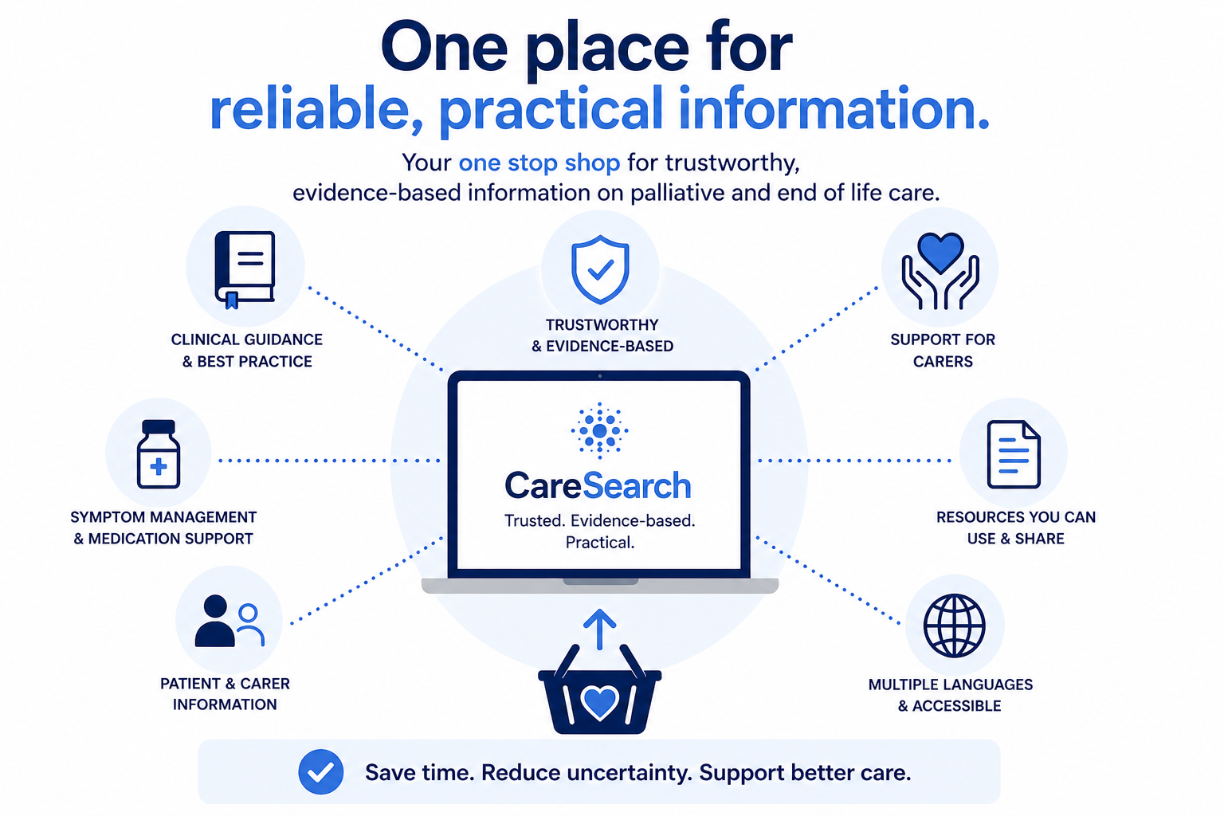


Slide 6
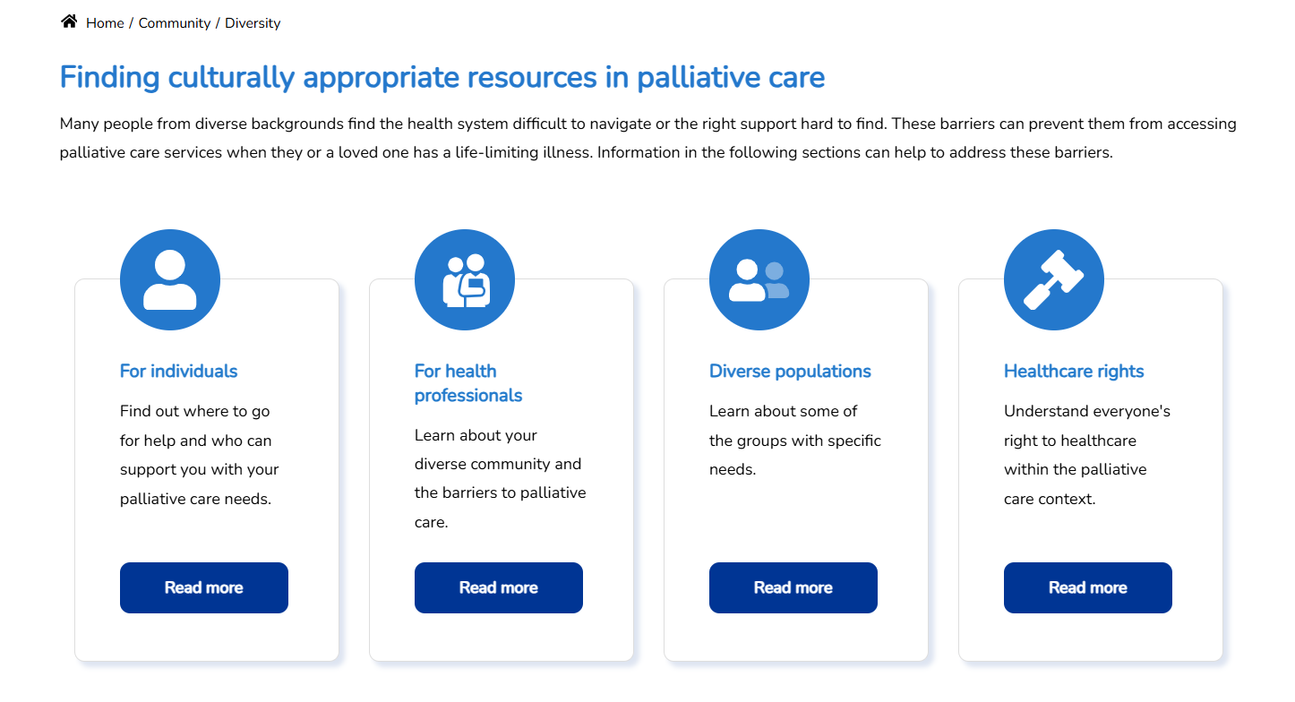
What CareSearch Offers
CareSearch is funded by the Australian Government Department of Health, Disability and Ageing

Slide 7
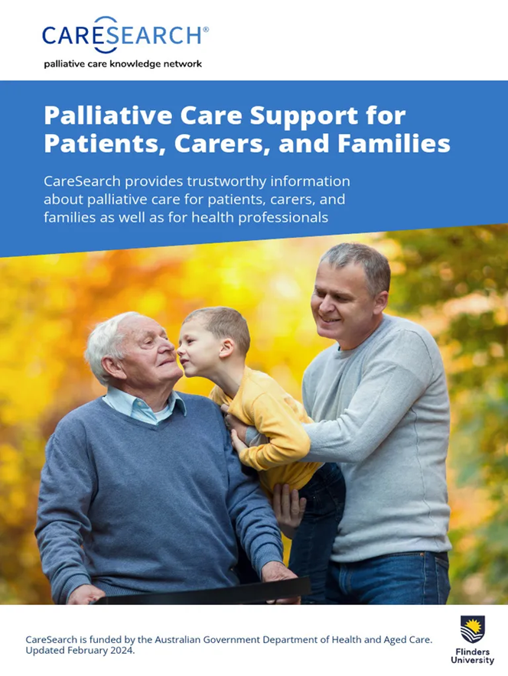

Diversity
Resources in multiple languages
Guidance on what to expect at end of life
Carer support and wellbeing resources
Free printed materials you can order
CareSearch is funded by the Australian Government Department of Health, Disability and Ageing

Slide 8
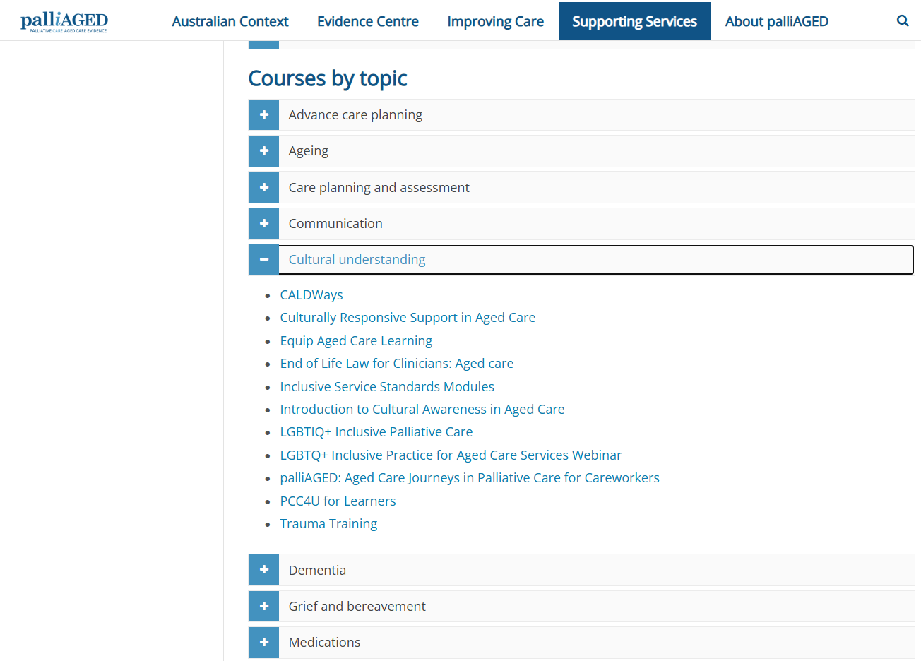
What CareSearch incl palliAGED offers
Practical resources for practice
Clinical evidence summaries (quick & practical)
Tools to support decision-making in practice
Further learning opportunities
CareSearch is funded by the Australian Government Department of Health, Disability and Ageing

Slide 9
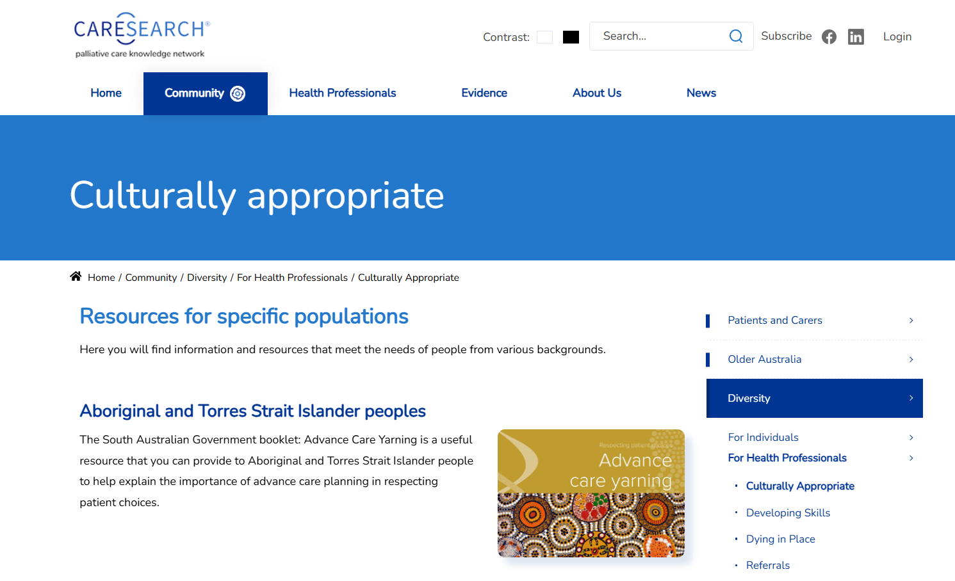
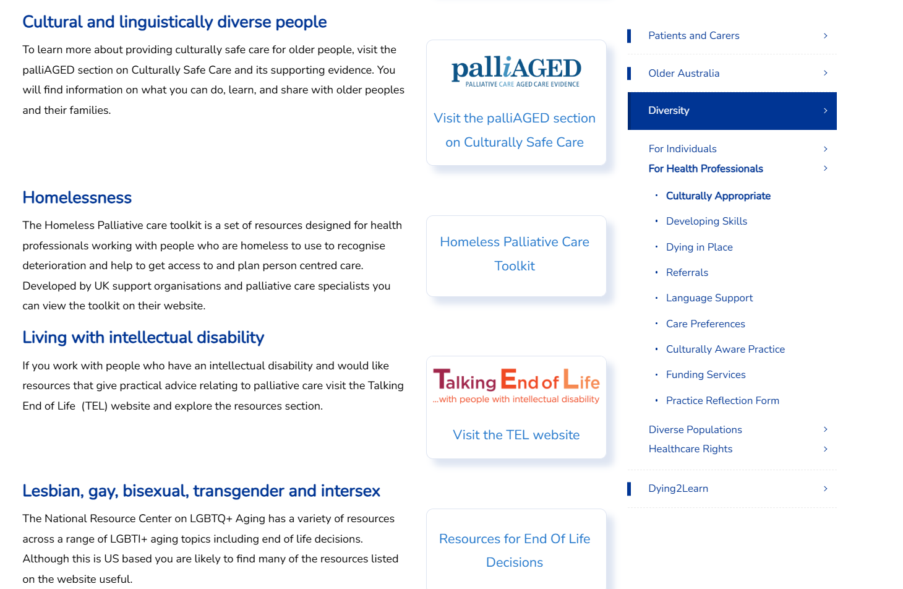
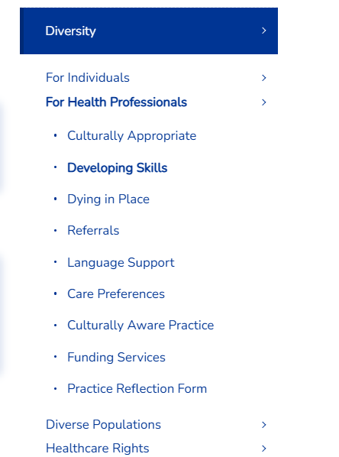

Slide 10

Case # 1 Grief as Withdrawal
84-year-old man with advanced COPD, Vietnamese background, limited English
Becoming more withdrawn; refuses meals, avoids staff
Daughter says: “He doesn’t want to talk about dying”
What’s happening: Loss of independence, appetite, role as family elder
Possible anticipatory grief + cultural beliefs about discussing death
Grief may present as withdrawal, not words
Strategies might include:
Use interpreter, is the person feeling isolated when family not there?
Ask family about preferences, what does culturally safe care look like?
Offer presence without forcing conversation
CareSearch is funded by the Australian Government Department of Health, Disability and Ageing
Notes:
Anticipatory grief refers to the emotional response to losses that occur before death, including loss of physical function, independence, social roles, and a sense of identity. For residents like Mr Nguyen, grief may be expressed through silence, withdrawal, or disengagement rather than verbal sadness. Cultural factors play a significant role in shaping how grief is understood and expressed. In some cultures, discussing death openly may be viewed as disrespectful or as taking away hope, which can influence both the resident’s and the family’s communication preferences. Staff may feel uncertain or uncomfortable when residents do not engage in conversations about their illness, but it is important to recognise that grief does not always require words. Effective responses focus on presence rather than problem-solving. Using professional interpreters can help ensure understanding and reduce isolation, while also allowing the resident to express concerns in their preferred language if they choose. Gentle, respectful interactions—such as sitting quietly, offering comfort, or supporting meaningful routines—can provide emotional support without forcing difficult conversations. Asking families about cultural preferences and documenting these can guide consistent care across the team

Slide 11

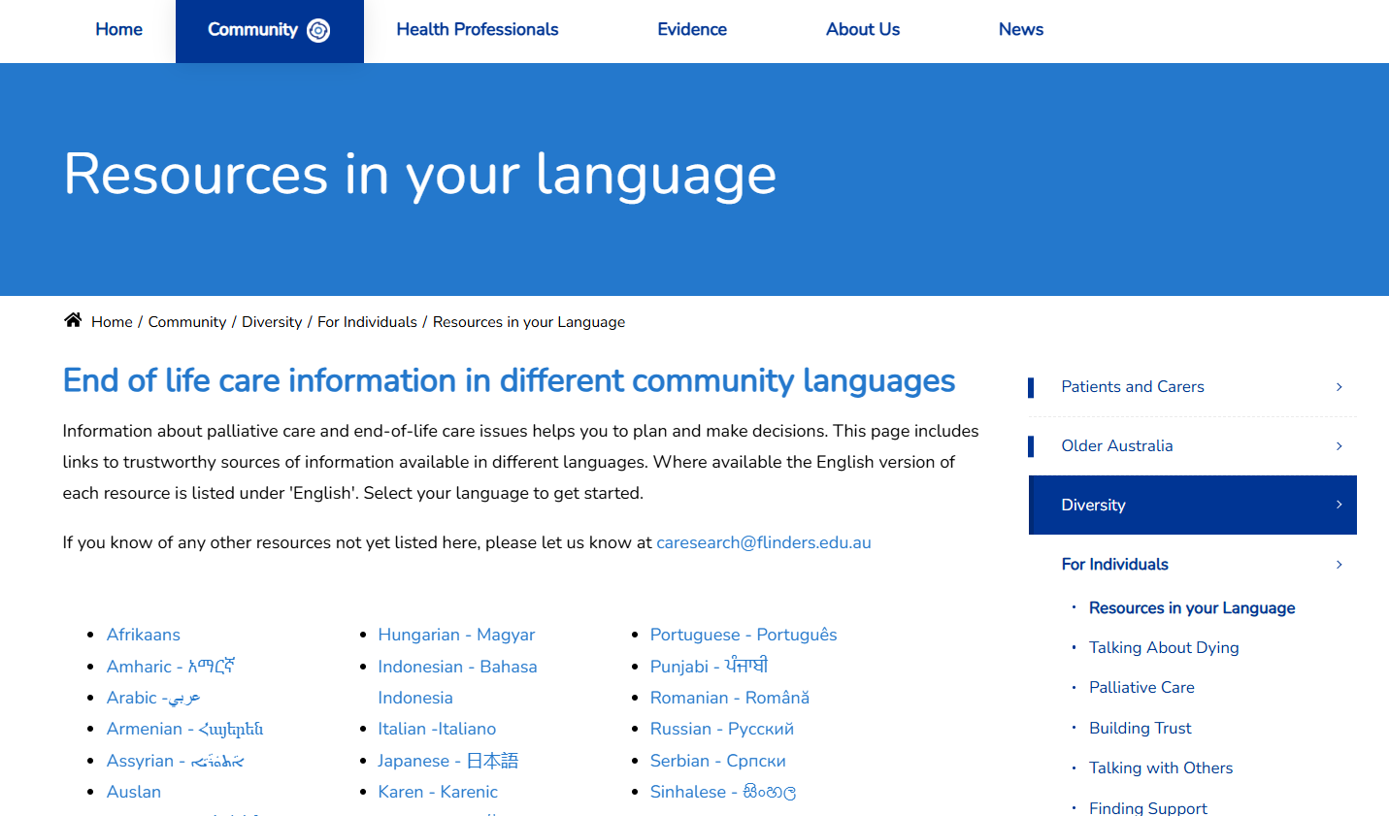
Case # 1 Grief as Withdrawal
84-year-old man with advanced COPD, Vietnamese background, limited English
Becoming more withdrawn; refuses meals, avoids staff
Daughter says: “He doesn’t want to talk about dying”
CareSearch is funded by the Australian Government Department of Health, Disability and Ageing
Notes:
Anticipatory grief refers to the emotional response to losses that occur before death, including loss of physical function, independence, social roles, and a sense of identity. For residents like Mr Nguyen, grief may be expressed through silence, withdrawal, or disengagement rather than verbal sadness. Cultural factors play a significant role in shaping how grief is understood and expressed. In some cultures, discussing death openly may be viewed as disrespectful or as taking away hope, which can influence both the resident’s and the family’s communication preferences. Staff may feel uncertain or uncomfortable when residents do not engage in conversations about their illness, but it is important to recognise that grief does not always require words. Effective responses focus on presence rather than problem-solving. Using professional interpreters can help ensure understanding and reduce isolation, while also allowing the resident to express concerns in their preferred language if they choose. Gentle, respectful interactions—such as sitting quietly, offering comfort, or supporting meaningful routines—can provide emotional support without forcing difficult conversations. Asking families about cultural preferences and documenting these can guide consistent care across the team

Slide 12

Case # 2 – Family / Carer Grief
Aisha is 72 with advanced cancer
Large family, Middle Eastern background & family insists: “Don’t tell her she is dying”. Staff feel conflicted about truth-telling.
What’s happening:
Family engaging in protective buffering
Cultural values around hope, protection, and decision-making
Strategies might include curious conversations:
Avoid “right vs wrong”
Ask, “what are you most worried might happen if she knew?”
Work towards a shared understanding of goals
Use experienced staff or cultural liaison if available
CareSearch is funded by the Australian Government Department of Health, Disability and Ageing
Notes:
Protective grief occurs when family members attempt to shield their loved one from painful information as a way of managing their own anticipatory grief. Cultural values often shape beliefs about disclosure, autonomy, and family responsibility, with some cultures emphasising collective decision-making over individual autonomy. Conflict can arise when staff and families hold different assumptions about what constitutes good care. Effective responses require moving away from a right-versus-wrong mindset and toward curiosity and exploration. Asking questions such as “What are you most worried might happen if she knew?” can help uncover underlying fears and values. Engaging in open, respectful dialogue allows staff to work toward shared goals of comfort, dignity, and respect. This case highlights the importance of cultural humility, skilled communication, and the use of experienced clinicians or cultural supports to navigate complex family dynamics around grief and dying.

Slide 13
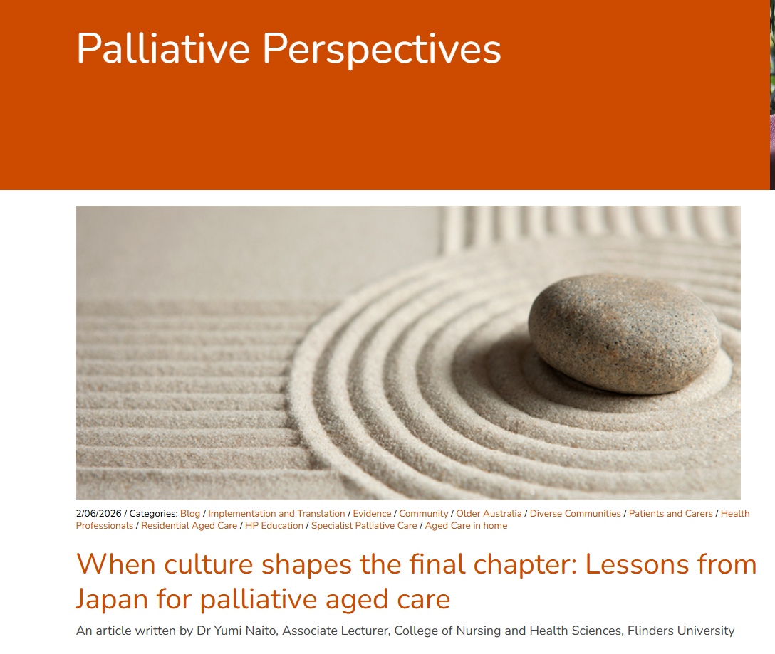
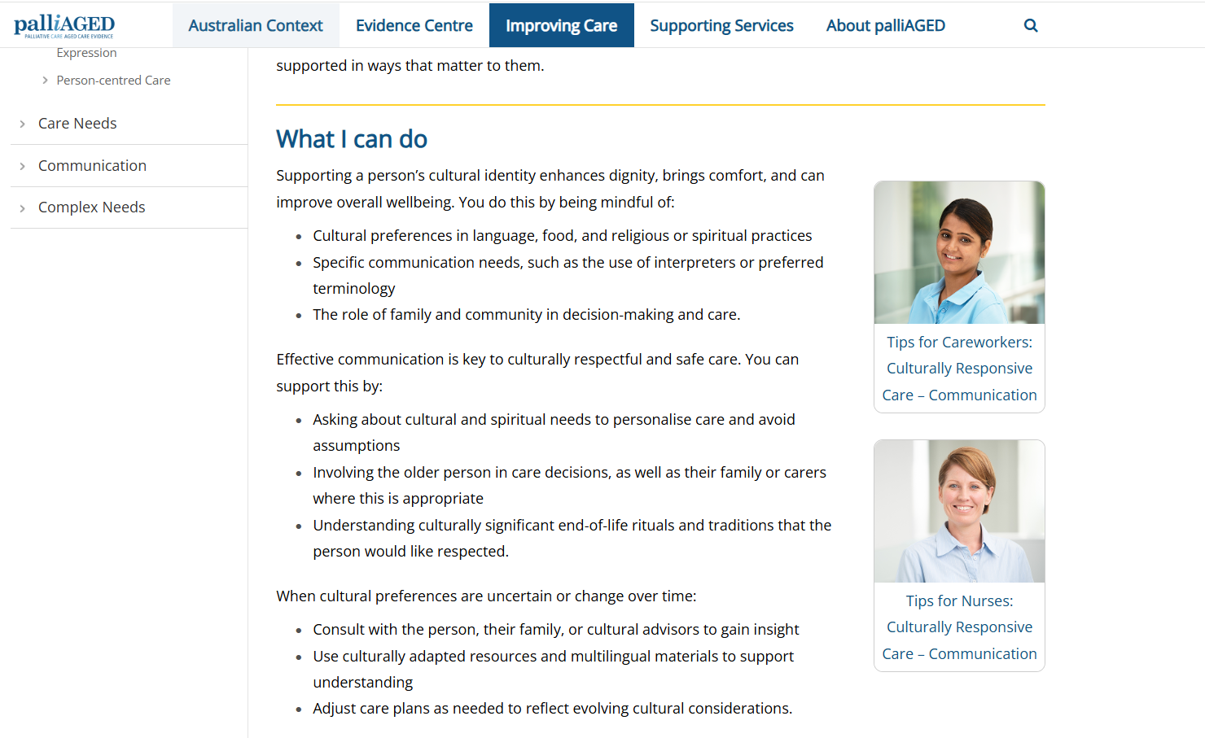
Case # 2 – Family / Carer Grief
Aisha is 72 with advanced cancer
Large family, Middle Eastern background & family insists: “Don’t tell her she is dying”. Staff feel conflicted about truth-telling.
Other resources:
https://grieflink.org.au/factsheets/grief-reactions-in-different-cultures/
CareSearch is funded by the Australian Government Department of Health, Disability and Ageing
Notes:
Protective grief occurs when family members attempt to shield their loved one from painful information as a way of managing their own anticipatory grief. Cultural values often shape beliefs about disclosure, autonomy, and family responsibility, with some cultures emphasising collective decision-making over individual autonomy. Conflict can arise when staff and families hold different assumptions about what constitutes good care. Effective responses require moving away from a right-versus-wrong mindset and toward curiosity and exploration. Asking questions such as “What are you most worried might happen if she knew?” can help uncover underlying fears and values. Engaging in open, respectful dialogue allows staff to work toward shared goals of comfort, dignity, and respect. This case highlights the importance of cultural humility, skilled communication, and the use of experienced clinicians or cultural supports to navigate complex family dynamics around grief and dying.

Slide 14

Case # 3 - Identity and Loss
Margaret, a 79-year-old former teacher with advanced dementia
Increasingly agitated when staff assist with dressing
Repeats: “I used to do this myself”
What’s happening:
Loss of identity, dignity, independence
“Living grief” expressed through behaviour = communication
CareSearch is funded by the Australian Government Department of Health, Disability and Ageing
Notes:
Grief in people with dementia is often overlooked or misunderstood, yet individuals may continue to experience emotional responses to changes in ability, dignity, and autonomy. In this case, grief is expressed through behaviour rather than conversation. Resistance to care, agitation, or repeated phrases can be meaningful indicators of distress and loss. Staff may feel challenged when behaviours escalate, but reframing these actions as communication can shift the care approach. Supporting Margaret’s identity involves acknowledging her past roles and preserving her sense of agency wherever possible. Simple strategies such as offering choices, maintaining familiar routines, and explaining each step of care can reduce distress and reinforce dignity. Even when memory is impaired, emotional memory remains significant, meaning that respectful and validating interactions can have a lasting positive impact.

Slide 15
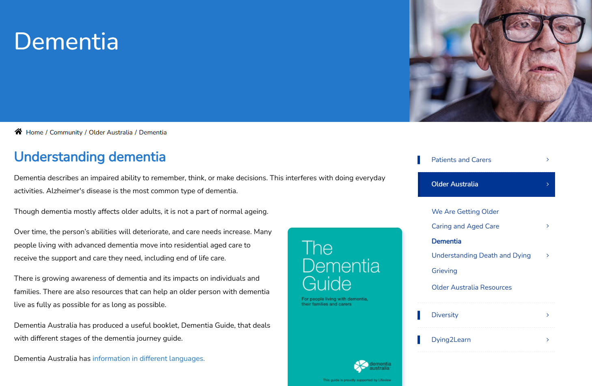
Case # 3 - Identity and Loss
Strategies might be around preserving identity:
Encourage choice
Use familiar routines
Acknowledge loss even if cognition is impaired
CareSearch is funded by the Australian Government Department of Health, Disability and Ageing
Notes:
Grief in people with dementia is often overlooked or misunderstood, yet individuals may continue to experience emotional responses to changes in ability, dignity, and autonomy. In this case, grief is expressed through behaviour rather than conversation. Resistance to care, agitation, or repeated phrases can be meaningful indicators of distress and loss. Staff may feel challenged when behaviours escalate, but reframing these actions as communication can shift the care approach. Supporting Margaret’s identity involves acknowledging her past roles and preserving her sense of agency wherever possible. Simple strategies such as offering choices, maintaining familiar routines, and explaining each step of care can reduce distress and reinforce dignity. Even when memory is impaired, emotional memory remains significant, meaning that respectful and validating interactions can have a lasting positive impact.

Slide 16
Case # 4 – Guilt and Anticipatory Grief
John has moved his wife into aged care due to advanced Parkinson’s disease
Visits daily but increasingly distressed and says: “I promised I’d never put her in a home”. May become demanding or complain about standard of care.
What’s happening:
Guilt + loss of role as caregiver
Anticipatory grief before death
Strategies might include:
Understanding and reassurance, let him know “This is really hard, we can see it’s not what you planned”
But daily visits is still caring
Offer ways for John to still be involved in his wife’s care e.g. helping at mealtimes, or mouthcare, gentle massage or playing favourite music/reading her a book
CareSearch is funded by the Australian Government Department of Health, Disability and Ageing
Notes:
Anticipatory grief may be accompanied by guilt, self-blame, and feelings of failure, even when placement was necessary for safety and care needs. John’s distress may manifest as sadness, anxiety, or frequent reassurance-seeking from staff. What he often needs most is validation rather than problem-solving. Statements that acknowledge the difficulty of the situation, such as recognising that this was not what he planned or wanted, can help reduce isolation. Reinforcing that John continues to care for his wife through visits, advocacy, and emotional presence can help reframe his role and ease guilt. Providing opportunities for involvement in care, where appropriate, can also support his ongoing connection

Slide 17
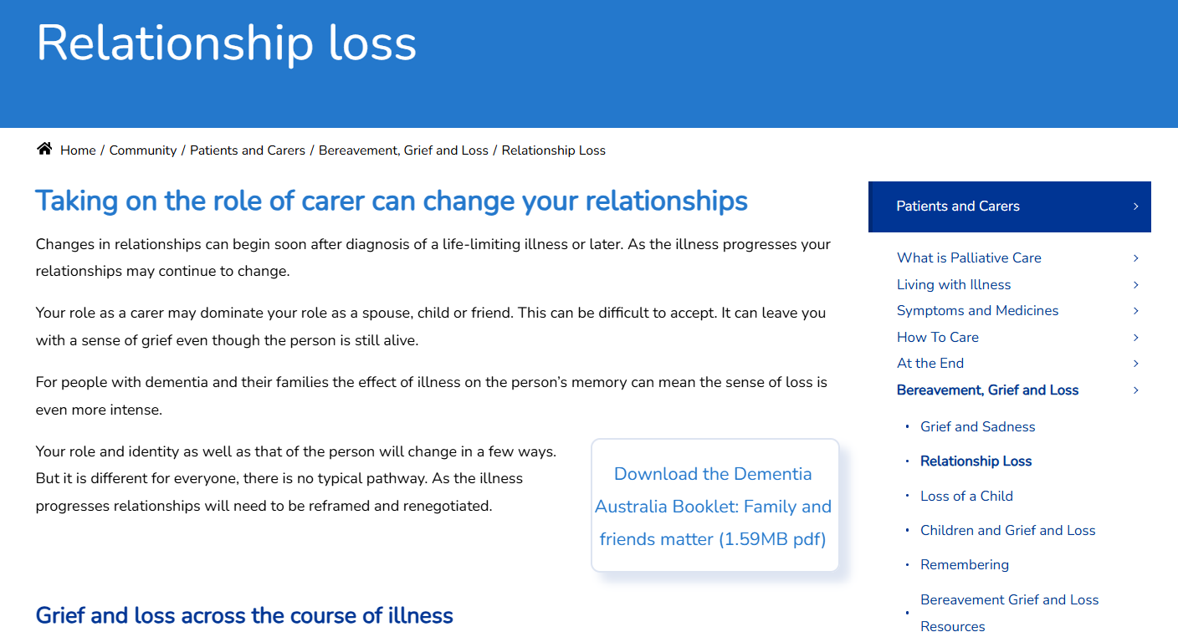
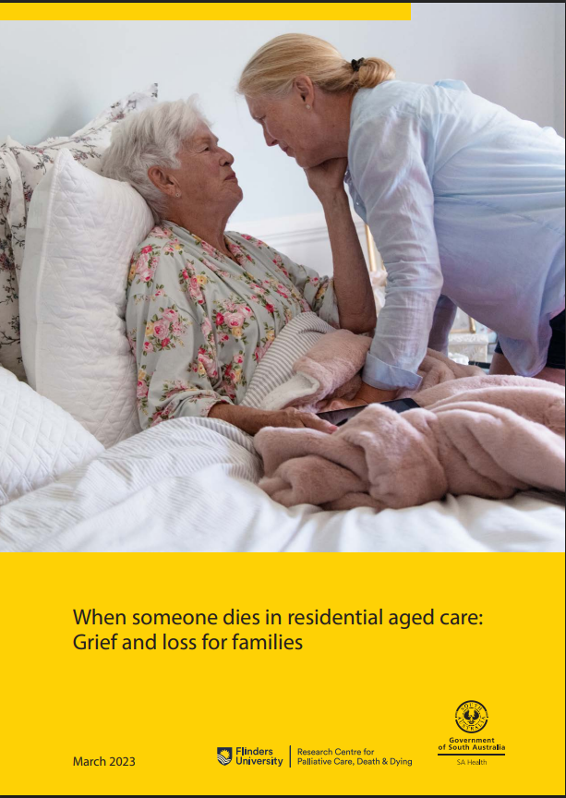
Case # 4 – Guilt and Anticipatory Grief
John has moved his wife into aged care due to advanced Parkinson’s disease
Visits daily but increasingly distressed and says: “I promised I’d never put her in a home”. May become demanding or complain about standard of care.
Resources:
https://www.caresearch.com.au/Community/Older-Australia/Grieving
CareSearch is funded by the Australian Government Department of Health, Disability and Ageing
Notes:
Anticipatory grief may be accompanied by guilt, self-blame, and feelings of failure, even when placement was necessary for safety and care needs. John’s distress may manifest as sadness, anxiety, or frequent reassurance-seeking from staff. What he often needs most is validation rather than problem-solving. Statements that acknowledge the difficulty of the situation, such as recognising that this was not what he planned or wanted, can help reduce isolation. Reinforcing that John continues to care for his wife through visits, advocacy, and emotional presence can help reframe his role and ease guilt. Providing opportunities for involvement in care, where appropriate, can also support his ongoing connection

Slide 18

Case # 5 – Staff Grief
Maria is a personal care worker
She worked closely with a resident for 3 years. After the resident’s death, she expected to continue in her shift but is struggling and feeling emotional. Says: “I feel silly being upset, it’s part of the job”
What’s happening:
Disenfranchised grief
Lack of permission to grieve
What we know about staff grief:
Staff grief is real and cumulative
Small supports matter i.e. Pause, acknowledgment, check-in
Leaders need to set the tone
Normalise emotional responses, and self-care supports
CareSearch is funded by the Australian Government Department of Health, Disability and Ageing
Notes:
Over time, unacknowledged grief can contribute to emotional exhaustion, burnout, and compassion fatigue. Small, supportive actions can make a meaningful difference, such as acknowledging the death, allowing a brief pause, or checking in with staff members. Leadership plays a key role in setting the tone by normalising emotional responses and creating a culture where grief is recognised as part of caring work. This case highlights that supporting staff grief is not an optional extra, but an essential component of sustainable, high-quality care.

Slide 19
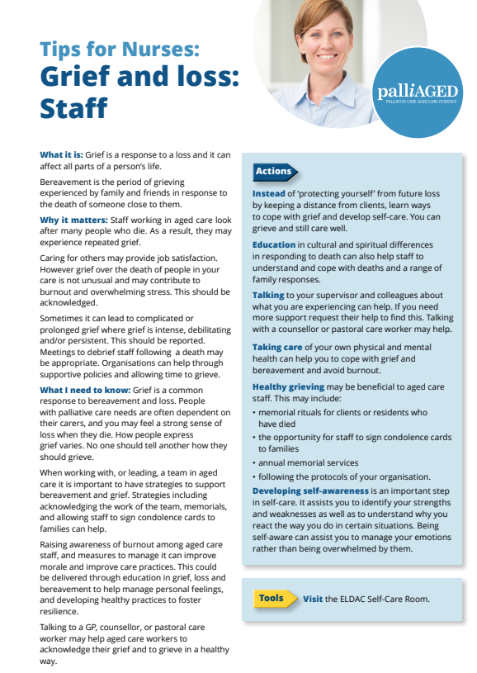
Case # 5 – Staff Grief
Alternatively, after a resident death:
One staff member cries
Another avoids the room
Another continues working as usual.
Tension arises: “Why don’t they care?”
Important to recognise different cultural expressions of grief
Strategies:
Encourage team conversations about, “How do you respond to death in your culture?”
CareSearch is funded by the Australian Government Department of Health, Disability and Ageing
Notes:
Cultural backgrounds strongly influence how grief is expressed and managed. Some cultures value emotional expression, while others emphasise stoicism, privacy, or continued duty. Misunderstandings can occur when staff judge one another’s responses through their own cultural lens. Promoting curiosity rather than judgement is key to maintaining team cohesion. Leaders and teams can support inclusive practice by acknowledging that there is no single ‘right’ way to grieve and by encouraging respectful conversations about differences. Creating psychological safety allows staff to express emotions in ways that feel appropriate to them. This case reinforces the importance of cultural awareness not only in resident and family care, but also in supporting a diverse workforce experiencing loss together.

Slide 20
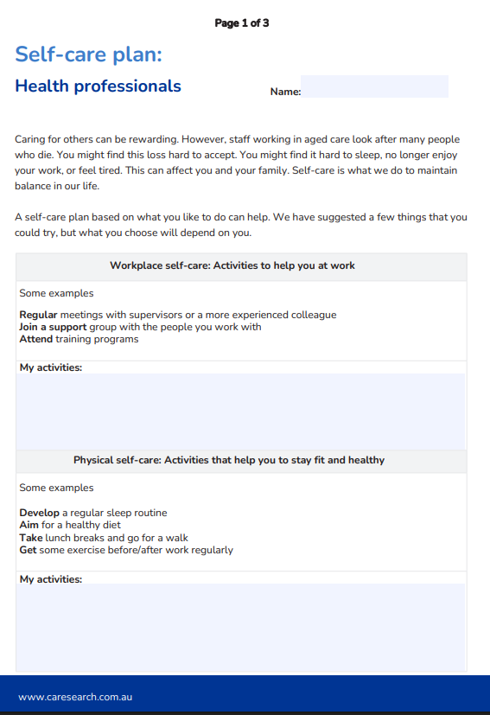
Supporting staff in managing grief
Build grief awareness into everyday care, not just at the moment of death
Simple communication skills, presence, listening, acknowledgement
Create supportive environments, time/space to pause after death
Use available resources, CareSearch and palliAGED grief/bereavement materials
Encourage reflective practice, “What did we learn from this experience?”
Further learning:
https://www.palliaged.com.au/Supporting-Services/Training-and-Education/Online-Learning/Culturally-Responsive-Support-in-Aged-Care
https://www.palliaged.com.au/Supporting-Services/Training-and-Education/Online-Learning/Introduction-to-Cultural-Awareness-in-Aged-Care
CareSearch is funded by the Australian Government Department of Health, Disability and Ageing
Notes:
Cultural backgrounds strongly influence how grief is expressed and managed. Some cultures value emotional expression, while others emphasise stoicism, privacy, or continued duty. Misunderstandings can occur when staff judge one another’s responses through their own cultural lens. Promoting curiosity rather than judgement is key to maintaining team cohesion. Leaders and teams can support inclusive practice by acknowledging that there is no single ‘right’ way to grieve and by encouraging respectful conversations about differences. Creating psychological safety allows staff to express emotions in ways that feel appropriate to them. This case reinforces the importance of cultural awareness not only in resident and family care, but also in supporting a diverse workforce experiencing loss together.

Slide 21
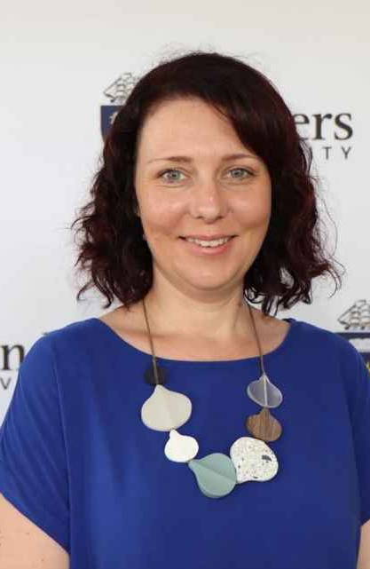



Thank you
CareSearch.com.au
CareSearch is funded by the Australian Government Department of Health, Disability and Ageing

